Slide 1
UIT2201 – Programming and Data Structures
Abstract Base Class

Slide 2
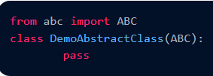

Abstract Base Class
In classic object-oriented terminology, we say a class is an abstract base class if its only purpose is to serve as a base class through inheritance. More formally, an abstract base class is one that cannot be directly instantiated, while a concrete class is one that can be instantiated.
A class is called an Abstract class if it contains one or more abstract methods. An abstract method is a method that is declared but contains no implementation.
Abstract classes may not be instantiated, and its abstract methods must be implemented by its subclasses.

Slide 3
Abstract Base Class in Python
In statically typed languages such as Java and C++, an abstract base class serves as a formal type that may guarantee one or more abstract methods.
This provides support for polymorphism, as a variable may have an abstract base class as its declared type, even though it refers to an instance of a concrete subclass.
Because there are no declared types in Python, this kind of polymorphism can be accomplished without the need for a unifying abstract base class.
For this reason, there is not as strong a tradition of defining abstract base classes in Python, although Python’s abc module provides support for defining a formal abstract base class.

Slide 4
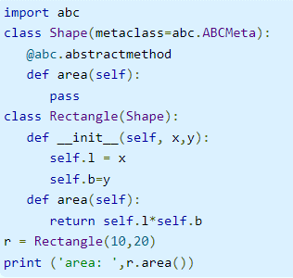
Example for Abstract Base Class
The abc module defines ABCMeta class which is a metaclass for defining abstract base class. Following example defines Shape class as an abstract base class using ABCMeta. The shape class has area() method decorated by abstractmethod.
A Rectangle class now uses above Shape class as its parent and implementing the abstract area() method. Since it is a concrete class, it can be instantiated and imlemented area() method can be called.
Note the abstract base class may have more than one abstract methods. The child class must implement all of them failing which TypeError will be raised.

Slide 5
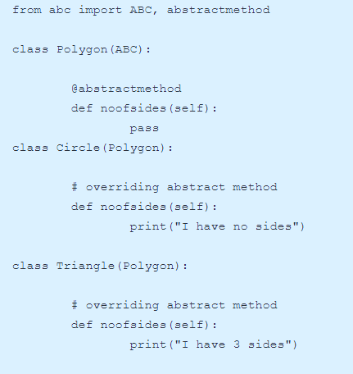
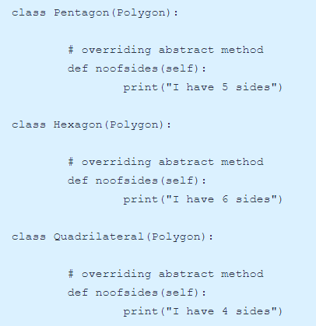
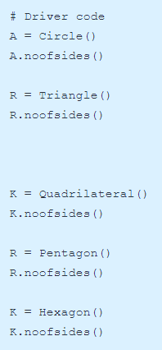
Python program to understand Abstract class

Slide 6
Collections in Python
Python programming language has four collection data types- list, tuple, sets and dictionary. But python also comes with a built-in module known as collections which has specialized data structures which basically covers for the shortcomings of the four data types.
The collections module has some concrete classes that derive from ABCs
Python’s collections module provides several abstract base classes that assist when defining custom data structures that share a common interface with some of Python’s built-in data structures.
These rely on an object-oriented software design pattern known as the template method pattern.
The template method pattern is when an abstract base class provides concrete behaviors that rely upon calls to other abstract behaviors.

Slide 7
Data structures in Collections
Specialized data structures in collections module.
namedtuple( )
deque
Chainmap
Counter
OrderedDict
defaultdict
UserDict
UserList
UserString

Slide 8
Collections.Sequence
The collections.Sequence abstract base class defines behaviors common to Python’s list, str, and tuple classes, as sequences that support element access via an integer index.
More so, the collections.Sequence class provides concrete implementations of methods, count, index, and contains that can be inherited by any class that provides concrete implementations of both len and getitem .

Slide 9
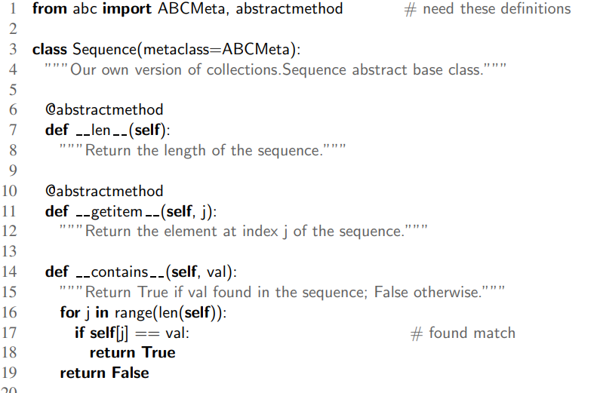
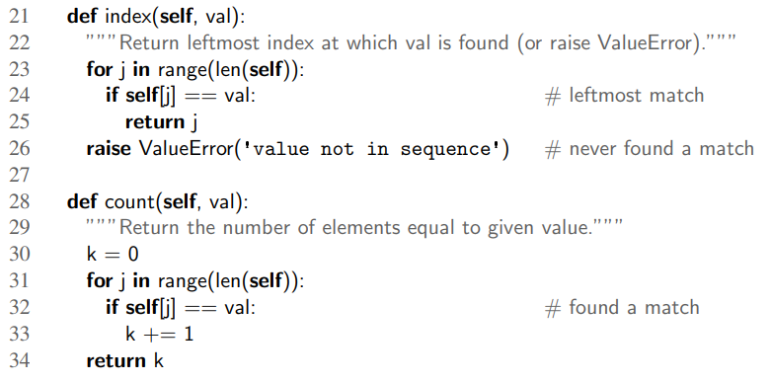
Sample implementation Sequence abstract base class

